Slide 1


Text To Speech
Hi! PARIS DataBootcamp 2025

Slide 2





Outline
Introduction to Text-to-Speech (TTS)
The Fundamentals of sound and speech
Demonstration
The Math Behind the Sound
Improving Prosody: The Paper's Approach
Conclusion
‹#›

Slide 3


Introduction to Text To Speech
‹#›
‹#›

Slide 4
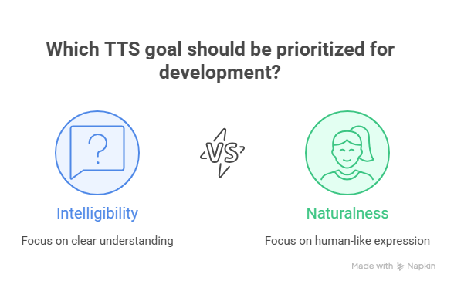
What is Text To Speech ?
Text-to-Speech (TTS) is a technology that converts written text into audible speech.
Focus on humain like expression
Focus on clear understanding
4

Slide 5
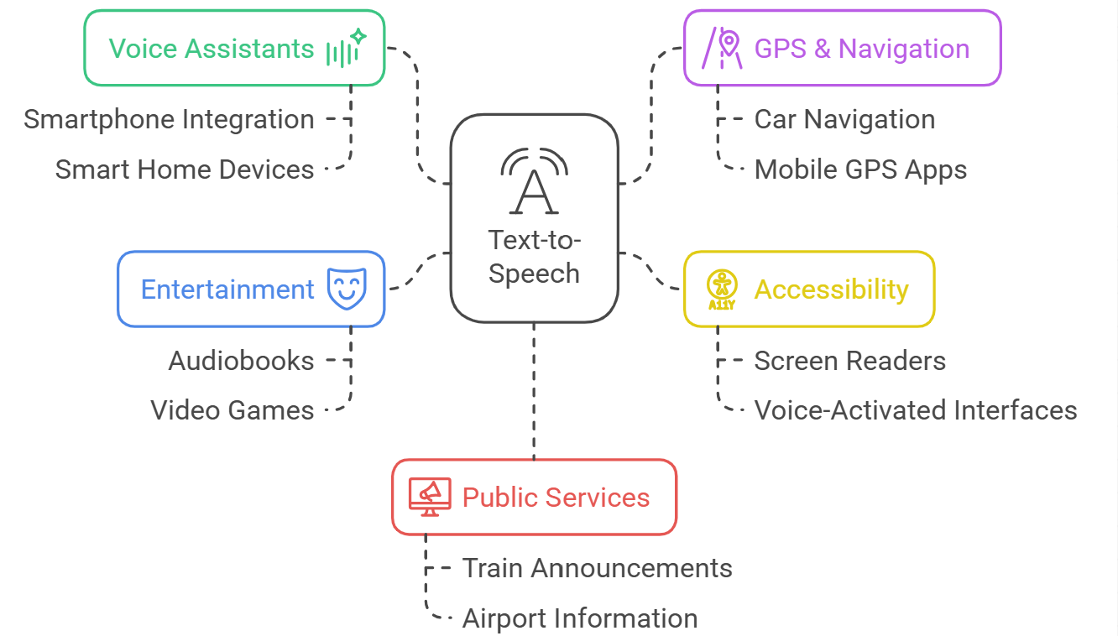
Applications of Text To Speech Technology
5

Slide 6
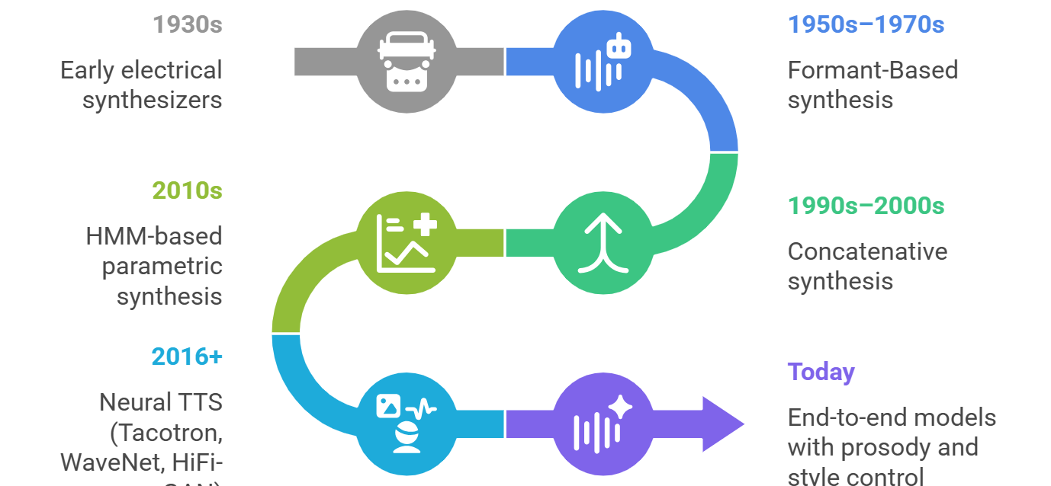
A Brief History of TTS
GAN)
6

Slide 7
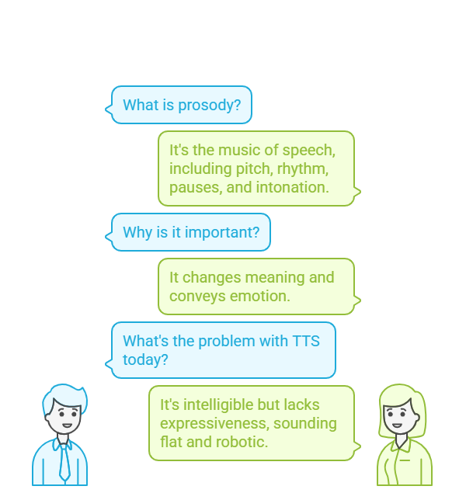
Why Prosody Matters in TTS
7

Slide 8
The Fundamentals of Sound and Speech
‹#›
‹#›

Slide 9
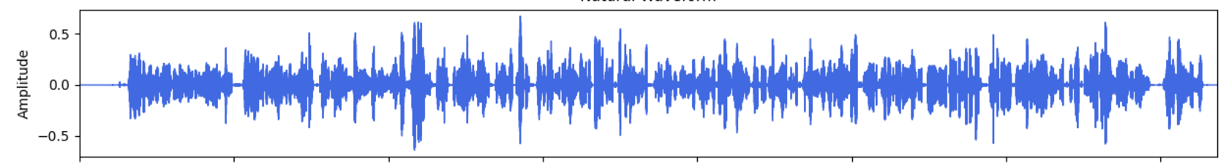
What is a Sound? The Waveform
A sound is a mechanical wave that propagates through a medium. We visualize it with a waveform.
The horizontal axis represents time.
The vertical axis represents amplitude (the intensity of the vibration).
Loudness: higher RMS amplitude generally corresponds to higher perceived loudness (it’s perceptual).
Time
Figure: Waveform (amplitude vs. time). Axes: Time (s), Amplitude (normalized).
10

Slide 10
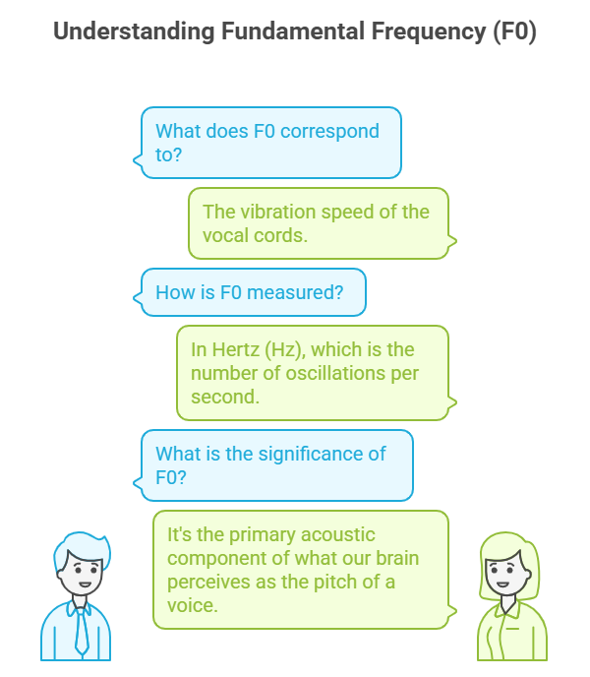
The Fundamental Frequency (F0)
11

Slide 11
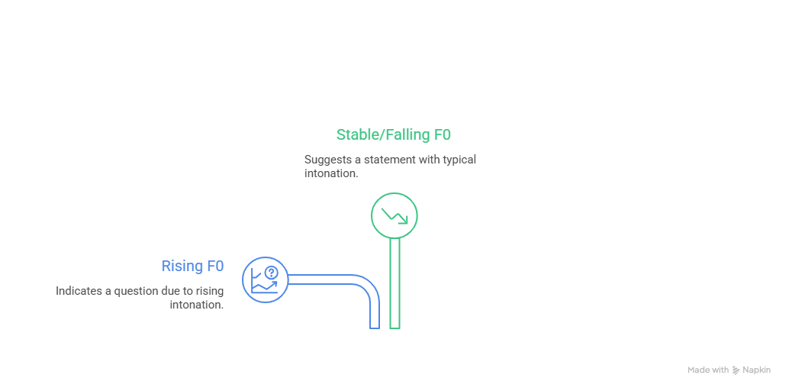
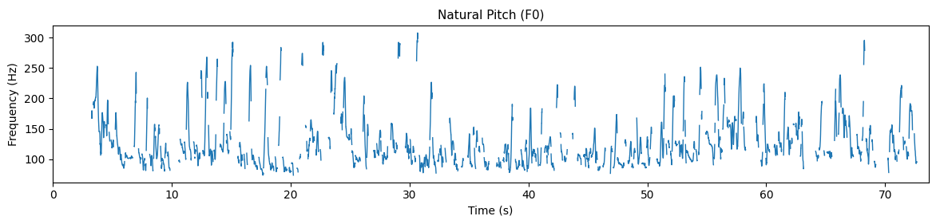
F0 Contour Visualization
12

Slide 12
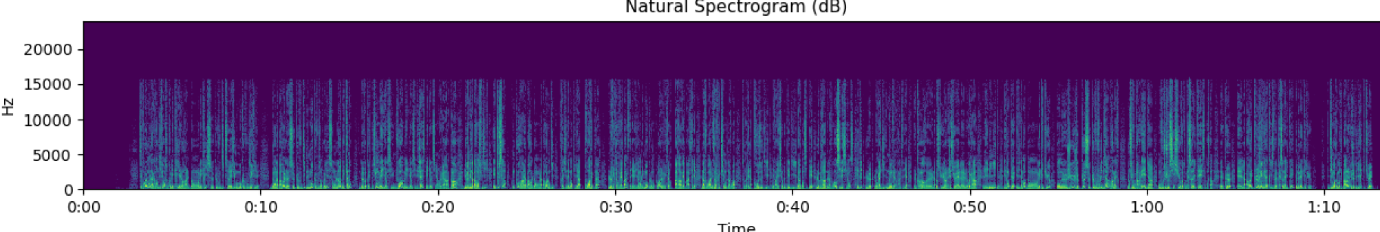
The Spectrogram: A Sound's ID Card
The spectrogram shows how the energy of the different frequencies in a sound evolves over time.
Natural spectrogram (dB)
Time
13

Slide 13
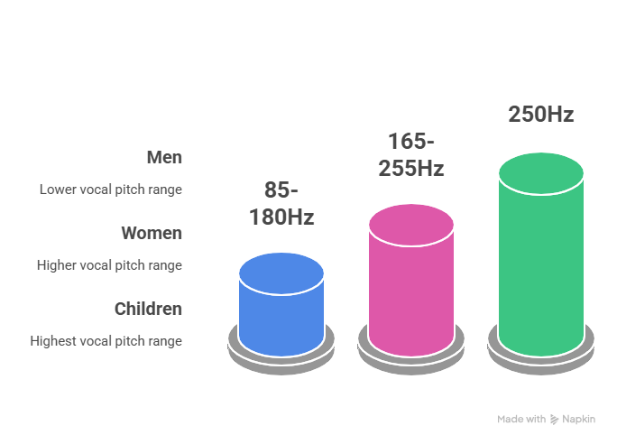
Pitch: The Vocal Signature
Pitch is strongly related to the fundamental frequency F0 (a physical measure of vocal fold vibration).
14

Slide 14
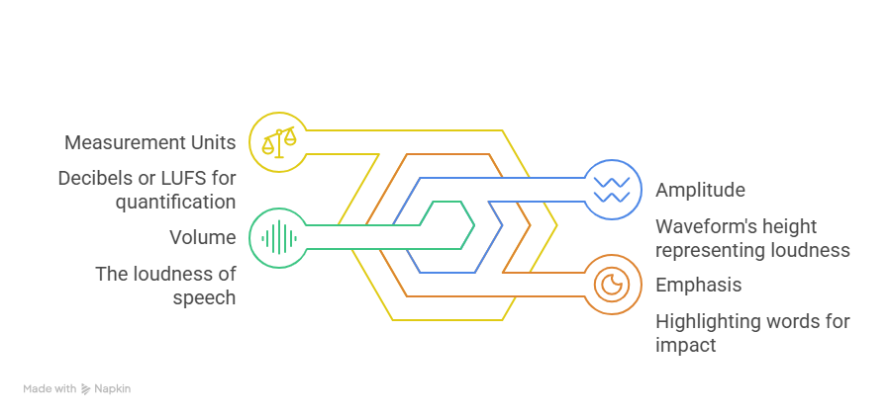
Volume of speech
15

Slide 15
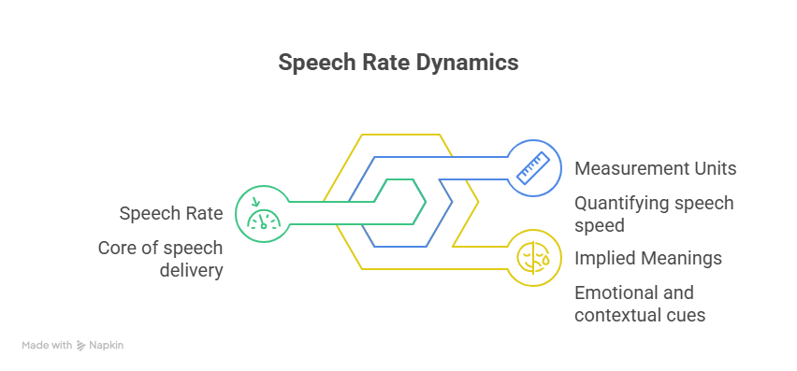
Rate of speech
16

Slide 16
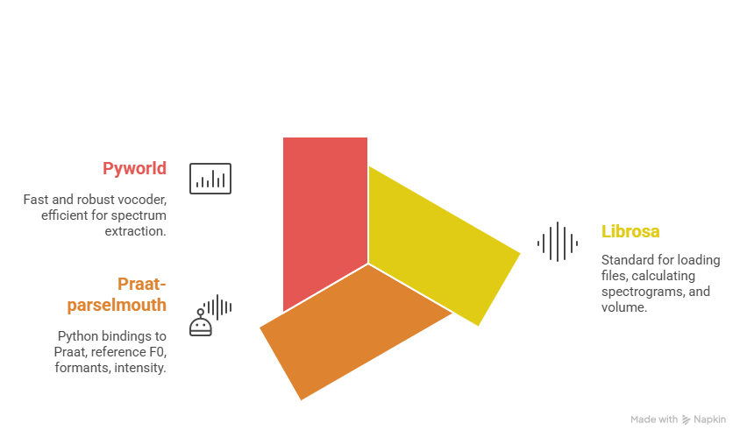
How Do We Compute All This?
In this work: spectrograms with librosa; F0 with pyworld (evaluation) and Praat (sanity checks)
17

Slide 17
Demo: How to compute prosody features
Waveform, Pitch (F0) and Spectrogram Analysis for Speech Synthesis

Slide 18
The Math Behind the Sound
‹#›
‹#›

Slide 19
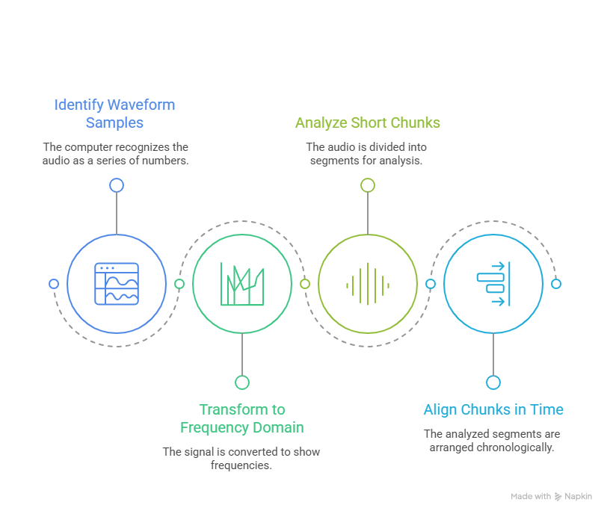
How does a Machine "Understand" Sound?
20

Slide 20
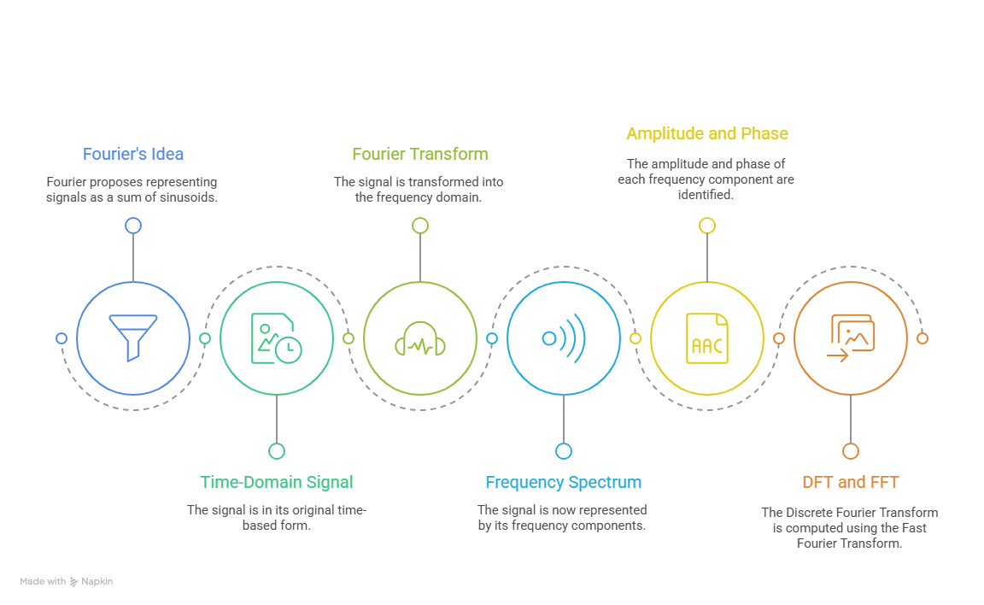
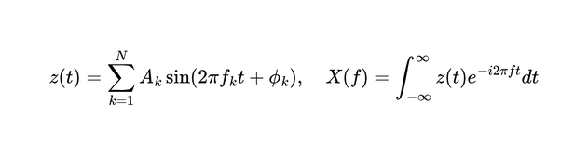
The Fourier Transform (FT)
21

Slide 21
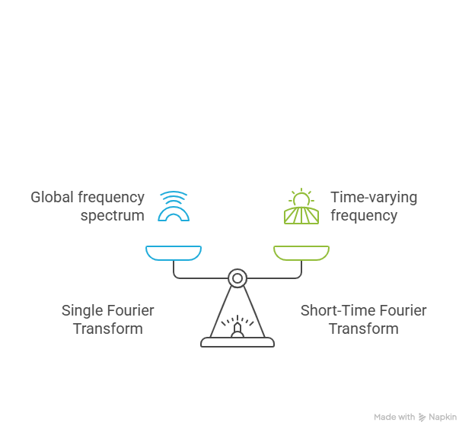
The Problem: Speech is Non-Stationary
22

Slide 22
STFT: Analyzing with Short Windows
We slice the signal into short, overlapping windows (e.g., 20–30 ms, hop ≈ 10 ms, Hann window).
For each window, we apply a Fourier Transform (FFT) to reveal its frequencies.
We stack the magnitude spectra in time → this gives a time–frequency view: the spectrogram.
Why overlap? It keeps changes smooth in time and avoids missing brief events.
23

Slide 23
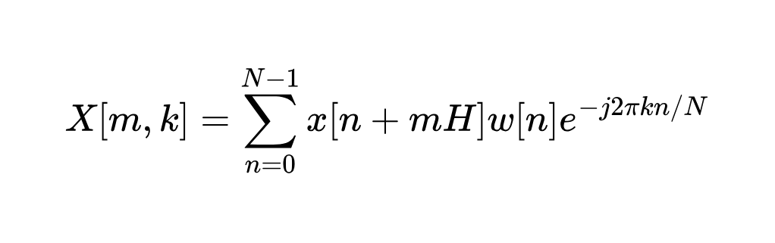
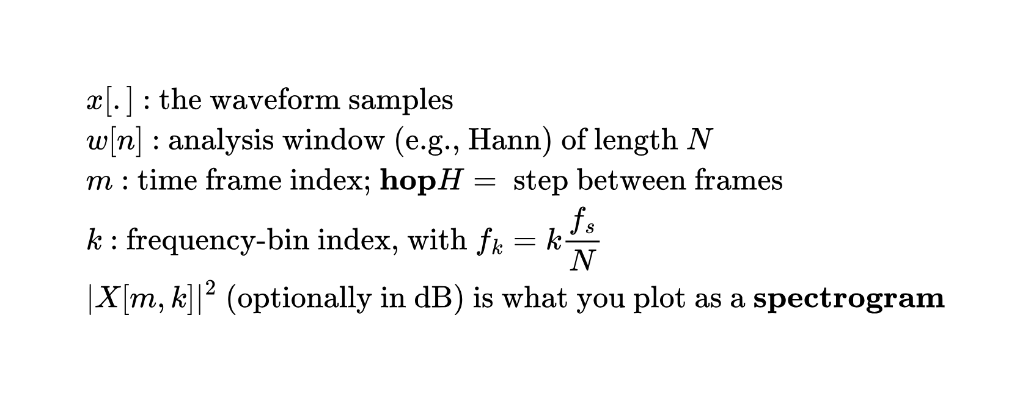
The STFT Formula (for the curious)
24
Notes:
‹#›

Slide 24
Improving Prosody: The Paper's Approach
‹#›
‹#›

Slide 25
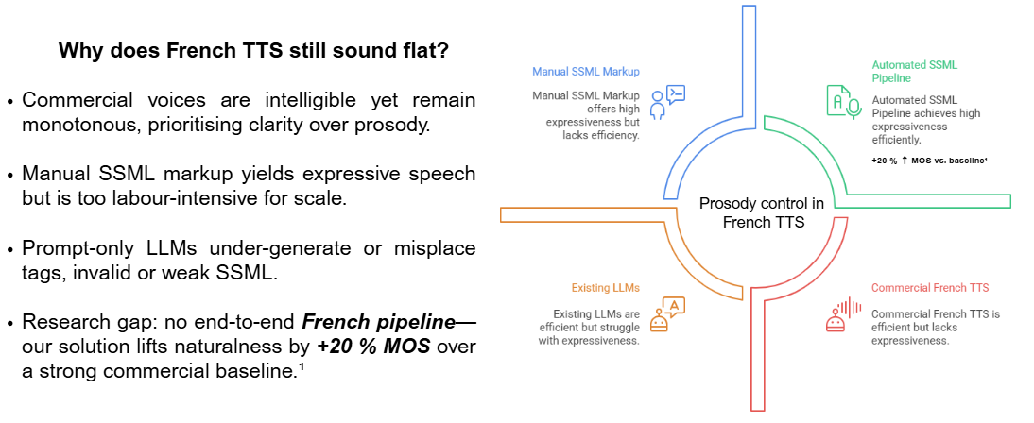
Back to the Problem: Monotone TTS
27

Slide 26
The Plan: Learning from Differences
The pipeline described in the paper:
We take a reference a human voice (from a podcast).
We generate the same sentence with a neutral synthetic voice (the "baseline").
For each segment, we calculate the prosodic deltas:
By what percentage is the human pitch higher/lower?
By how much is the rate faster/slower?
What is the duration of the pauses in the human voice?
These deltas become our modification coefficients.
28

Slide 27
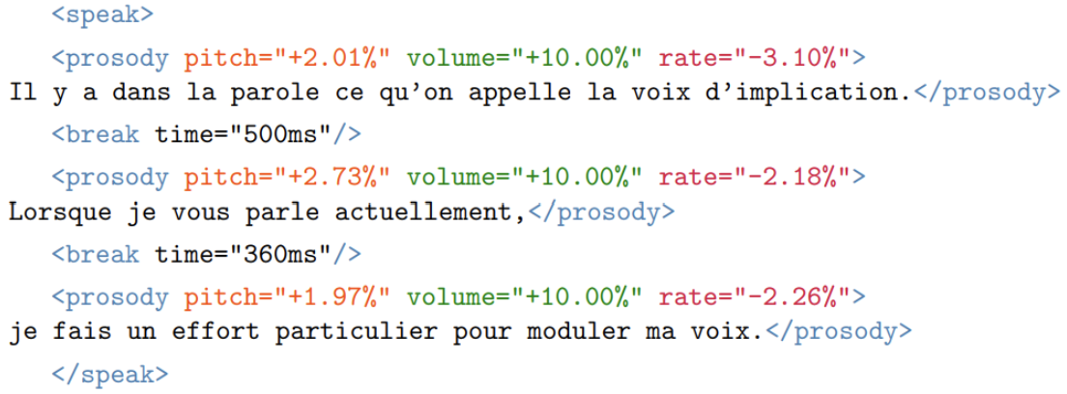
The Plan: Learning from Differences
We use the Speech Synthesis Markup Language (SSML) to apply these modifications.
29
Notes:
‹#›

Slide 28
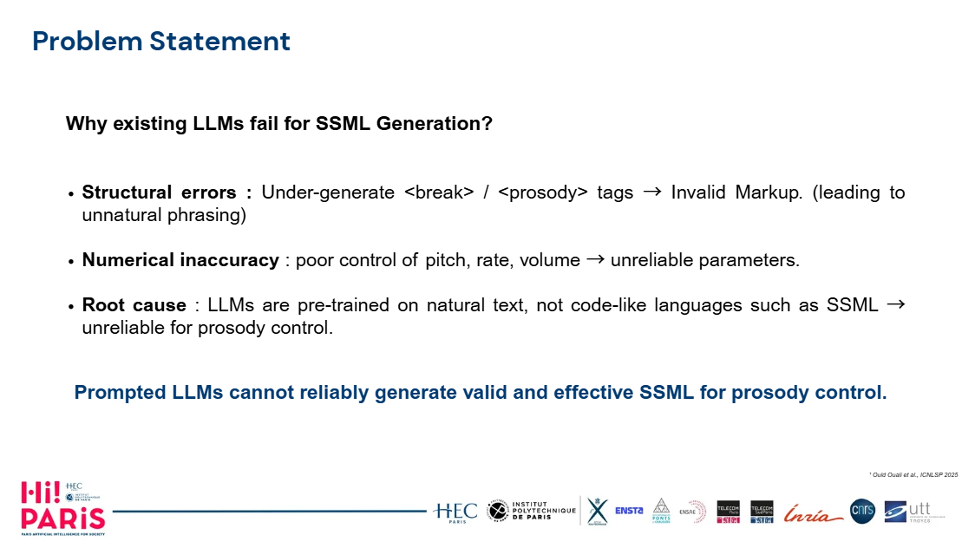
The Plan: Learning from Differences
‹#›
‹#›
30

Slide 29
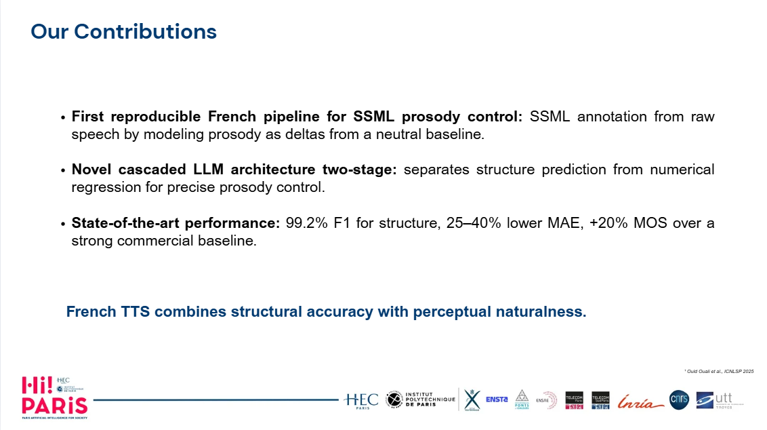
Computing the Pitch Coefficient
‹#›
‹#›
31
Notes:
‹#›

Slide 30
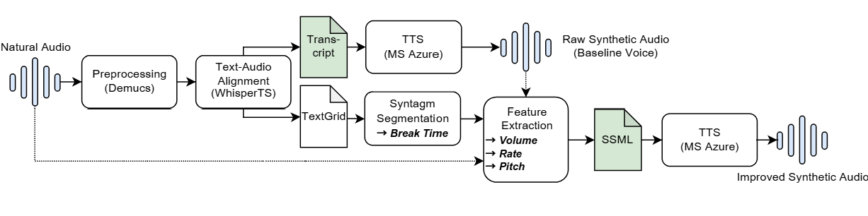
Annotation Pipeline
‹#›
‹#›
32

Slide 31
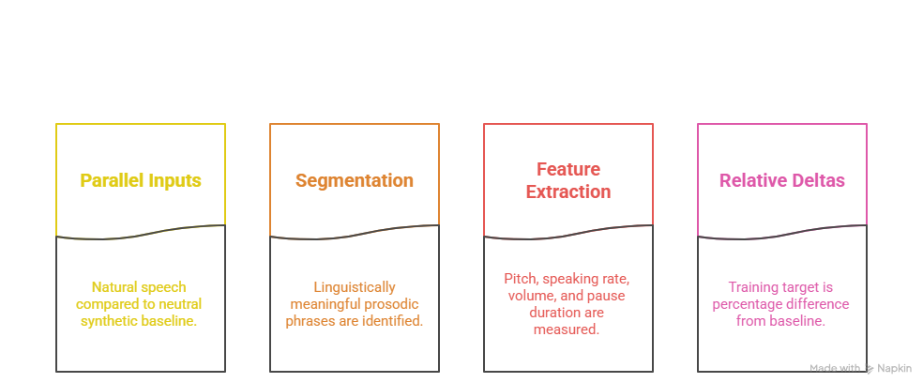
Prosodic Feature Extraction
‹#›
‹#›
33

Slide 32
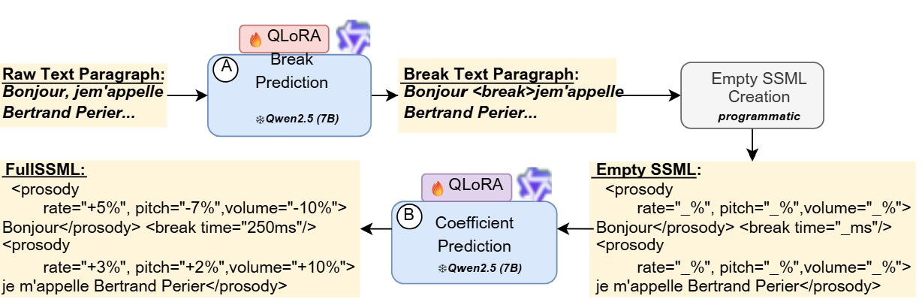
Model Architecture
‹#›
‹#›
34
Notes:
‹#›

Slide 33
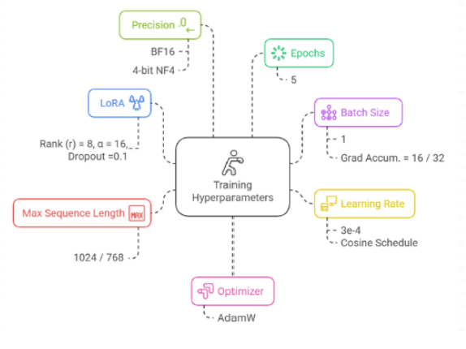
Training and Evaluation Setup
‹#›
‹#›
35

Slide 34
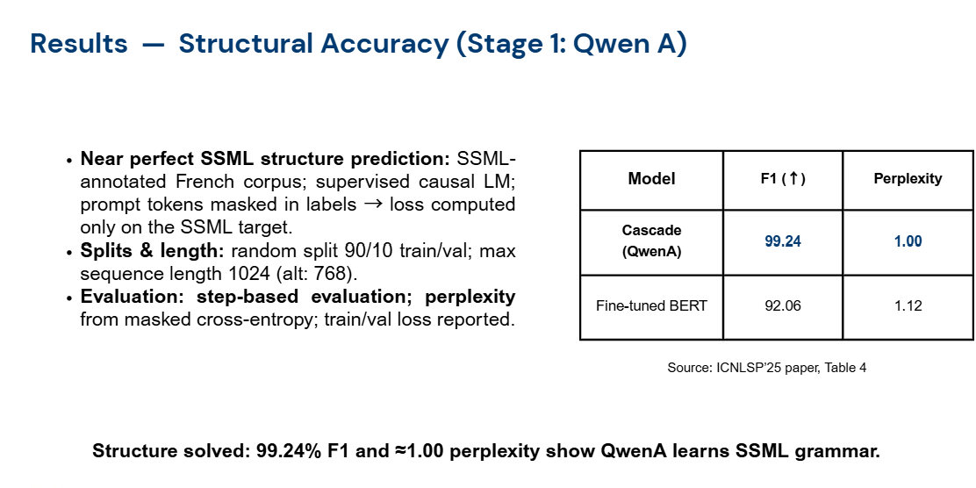
36
Notes:
‹#›

Slide 35
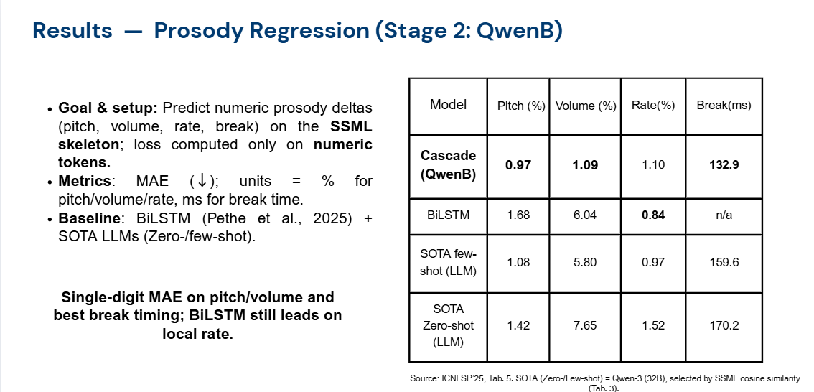
37
Notes:
‹#›

Slide 36
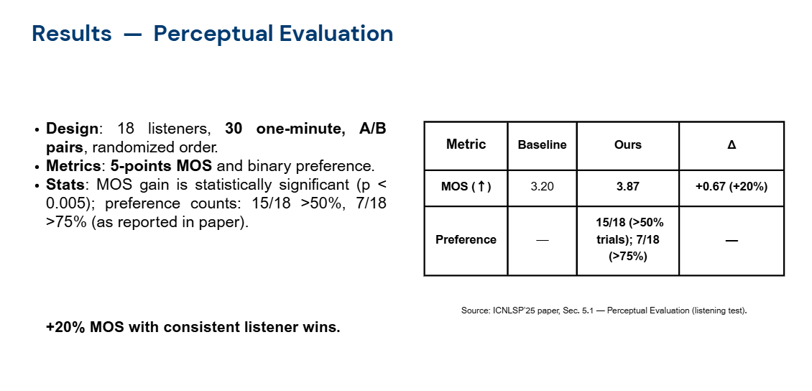
38
Notes:
‹#›

Slide 37
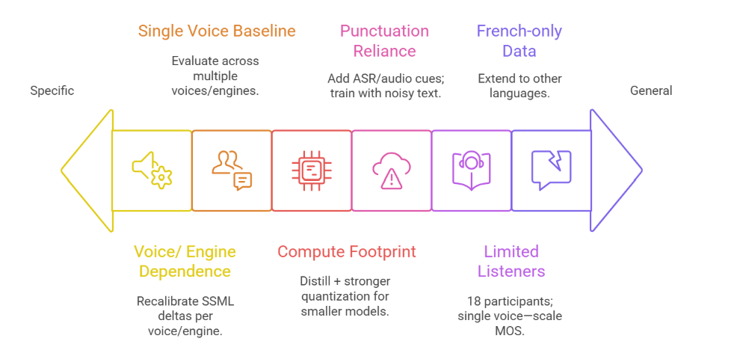
Limitations and Ethics
39

Slide 38
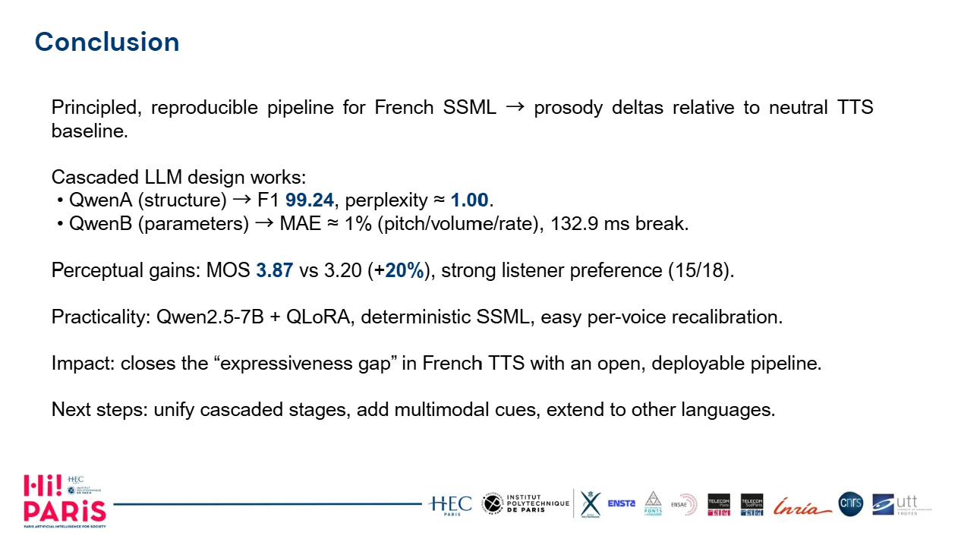
‹#›
‹#›
40

Slide 39

Thank you for listening
🎤 Questions and discussion
nassima.ould-ouali@polytechnique.edu
41

